Slide 1
Cancer
Lesson 1.4
How can we identify a novel carcinogen?

Slide 2
Do Now
What did Bruce Ames say about how useful the Ames test is at identifying carcinogens?
How would you prove HPV causes cervical cancer?

Slide 3
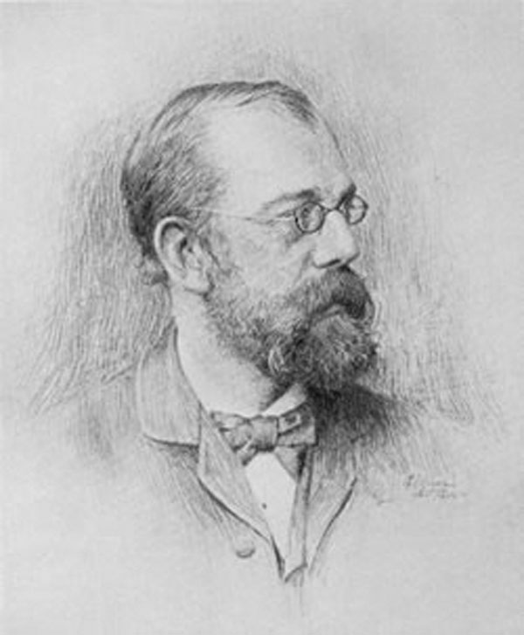
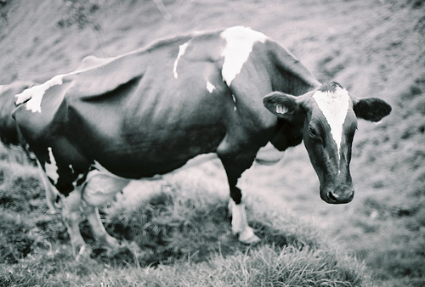
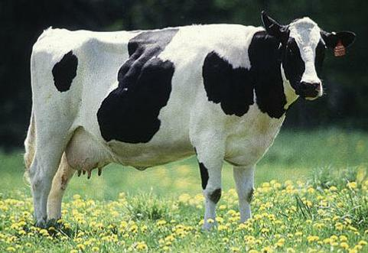
Who was Robert Koch?
Robert Koch
Identify that there is a disease.
Connecting the dots to disease
The animal should get the same disease as the original animal
Isolate the agent suspected of causing the disease
Re-introduce the agent into a healthy animal

Slide 4
Robert Koch’s postulates – An infectious microbe must:
Associate with every case of the disease
Be isolated from the sick animal
Cause the disease when introduced into a second healthy animal
Be the same microbe when re-isolated from the second sick animal.
Which of these could we do to show that
HPV causes cervical cancer?

Slide 5
Can you give an example of a carcinogen known to cause cancer?
Could you use Koch’s postulates to prove it?
No, because we couldn’t isolate the carcinogen from the person, unlike an infectious agent and it would be unethical to use cigarettes to try to produce cancer in a healthy person

Slide 6
What is the major problem if you can’t use Koch’s postulates to prove causation for a particular carcinogen?
If we cannot definitively establish that an agent causes cancer, it is difficult to make the argument that people need to change their behavior to prevent cancer

Slide 7
The problem of causation vs. correlation
What is the difference between them?
Correlation = relationship between 2 variables
Causation = one variable causes a change in the other variable
Why is it important?

Slide 8
Determining causation vs. correlation
Different types of study:
Observational (epidemiological)
Ex. How many people in this lung cancer population, smoke?
Interventional
Ex. How many people in this population who smoke, develop cancer?
Randomized control studies
Ex. If we randomly give half the people cigarettes to smoke, how many will develop lung cancer compared to the non-smokers
Can’t do randomized control studies with cancer in humans!

Slide 9
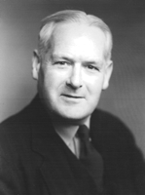
Bradford Hill - wrestling with correlation
Hill ran a controlled study showing that cigarette smoking correlated with lung cancer.
He could not prove ‘causation’ by Koch’s standards. Observational and Interventional studies cannot prove causation.
But by eliminating alternate explanations, he could statistically show causality in complex diseases like cancer.
Bradford Hill (1897 – 1991)

Slide 10
How Hill’s postulates work
Each postulate eliminates alternate explanations.
The more postulates fulfilled, the less likely it is to be a correlation, the more likely it is to be causation.
Postulates must fulfill scientific rigor.

Slide 11
Hill’s postulates The relationship between a proposed carcinogen and a cancer must be:
Plausible
Strong
Consistent
Specific
Coherent
Time - Cause has to precede effect
Dose - Bigger doses must produce larger effects
Different forms of the carcinogen must behave similarly
Different circumstances of exposure must give similar results

Slide 12
Hills’ postulates for cigarette smoking and cancer
Plausible
Strong
Consistent
Specific
Coherent
Time
Dose
Different forms give same results
Different exposure gives same result
Smoke is inhaled: cancer is in the lung
Smokers have a 5-10 fold higher risk of lung cancer
Two independent studies came up with the same result
Smoke enters mouth & lung. Cancer is in mouth & lung
All studies on tobacco tar give similar results
Likelihood of cancer related to time person smokes
Likelihood of cancer related to amount a person smokes
Painting tobacco tar on the skin also causes cancer
Smoking also correlated with lung, lip, throat and esophageal, also exposed to tobacco tar.

Slide 13
Activity:
Use Hill’s postulates to identify whether the following agents act as carcinogens:
HPV and Cervical Cancer
Sunbathing and Skin Cancer
Cell Phones and Brain Cancer
Obesity and Breast Cancer

Slide 14
Wrap up Do Hill’s postulates prove causation?
From the evidence which relationships do you think are causal?
Strong Relationships – HPV/Cervical Cancer & Tanning/Skin Cancer
Weaker Relationships – Obesity/Breast Cancer & Cell Phone/Brain Cancer
How many postulates are required to prove causality ?
Can’t ever prove causality, but the more postulates supported the higher the likelihood
Are some postulates more important than others?
NO
If there is evidence supporting each postulate does that mean the relationship is likely to be causal?
No, quality of evidence is important/confounding variables may play a role at any time

Slide 15
The Challenge of Causality
If a behavior can be associated with cancer and stopping that behavior can be shown to decrease cancer, then this correlation is effectively equivalent to causation.
But if a strong argument can’t be made upfront, then it is difficult to get people to change behavior.
See reading on tobacco and lung cancer.

Slide 16
Homework
Lesson 1.4 Homework - The Case Against Smoking
Read the chapter from The Emperor of All Maladies that describes how tobacco companies exploited the challenges of proving causality to avoid regulation.
Answer the questions that follow.

